Slide 1
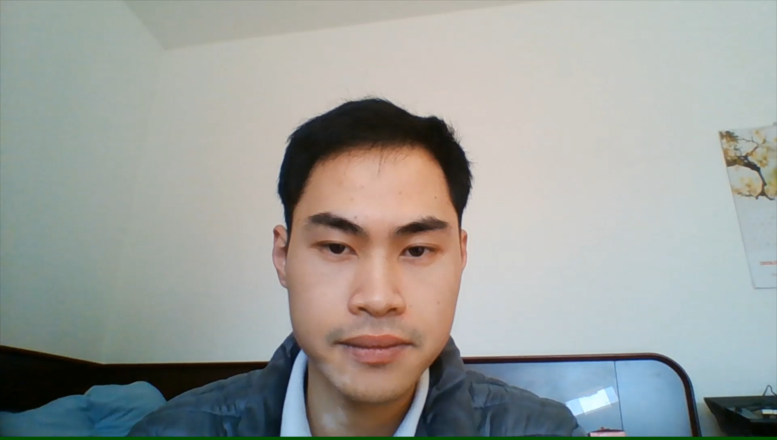
Investigation of Hierarchical Temporal Memory Spatial Pooler’s Noise Robustness and Specificity
Sang Nguyen
phuocsangnguyen97@gmail.com
Duy Nguyen
ngthanhduy7@gmail.com
Fachbereich 2 Informatik und Ingenieurwissenschaften

Slide 2

Contents
Introduction
Methods
Results and Discussion
Conclusion

Slide 3
Introduction
HTM Cortex Layer
Encoder
Spatial Pooler
Temporal Memory
Robustness

Slide 4
Introduction
Specificity - the ability to differentiate between two different inputs

Slide 5
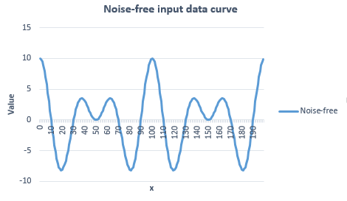
Methods – making training data
f(x) = 10 ∙ cos(0.01π ∙ x) ∙ cos(0.05π ∙ x)
Figure 1. The 200 samples from the original input data set

Slide 6
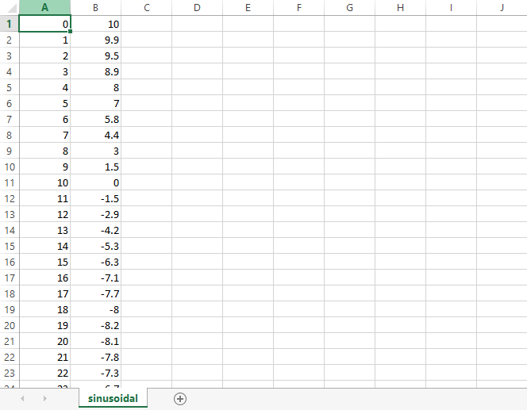
Methods – making training data

Slide 7
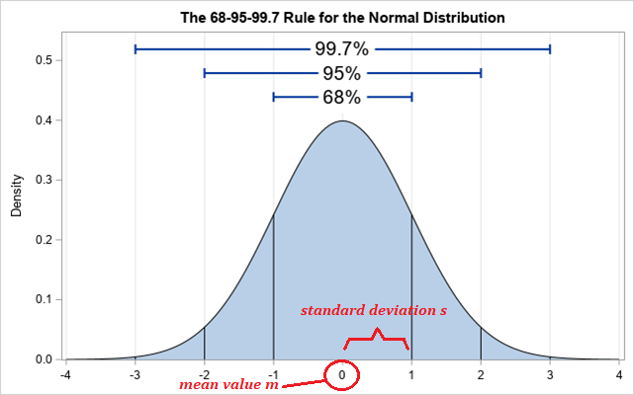
Methods – making noisy data
(Source: https://blogs.sas.com/content/iml/2019/07/22/extreme-value-normal-data.html#prettyPhoto)

Slide 8
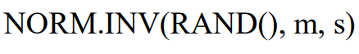
Methods – making noisy data

Slide 9
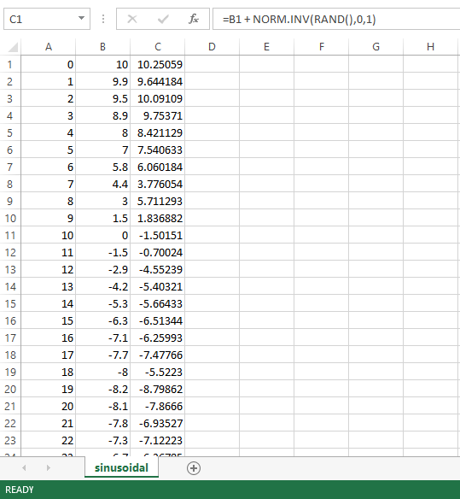
Methods – making noisy data

Slide 10
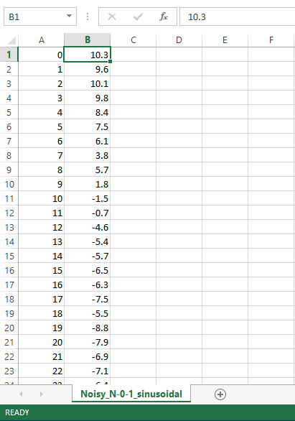
Methods – making noisy data

Slide 11
Methods – making noisy data
Noise level: The ratio between standard deviation s and input resolution

Slide 12
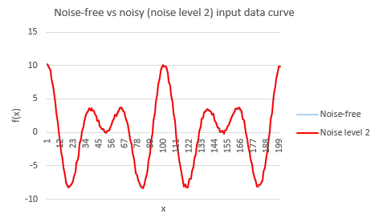
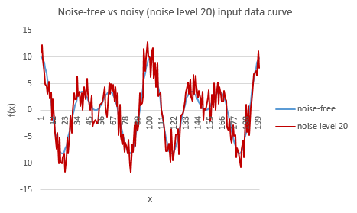
Methods – making noisy data
Figure 2. Comparison between original and noisy input data sets

Slide 13

Methods – making specificity data

Slide 14
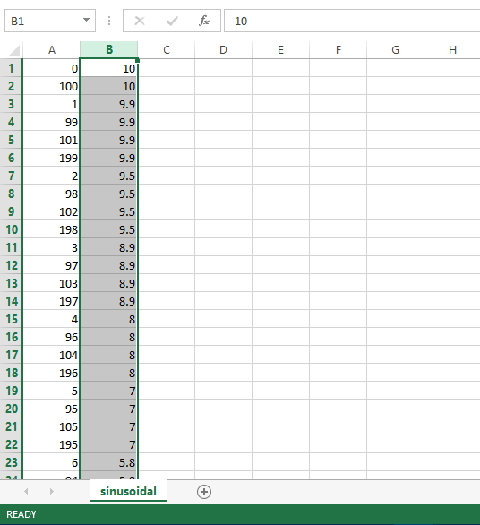
Methods – making specificity data

Slide 15
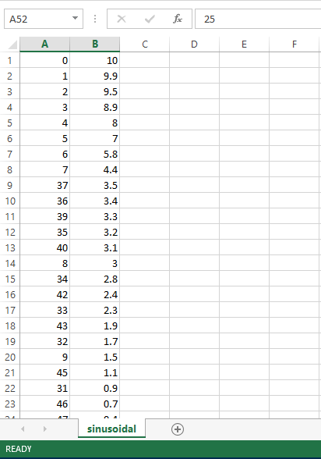
Methods – making specificity data

Slide 16
Methods – Scalar Encoder‘s settings
Table 1. Scalar Encoder’s Settings
Parameter | Value
W | 65
N | 465
MinVal | -20.0
MaxVal | 20.0
Periodic | false
ClipInput | true
Offset | 108
=> Resolution 0.1

Slide 17
Methods – Spatial Pooler‘s settings
Table 2. Spatial Pooler’s Settings
Parameter | Value
inputDimensions | 465
comlumnsDimension | 2048
potentialRadius | -1
potentialPct | 1
globalInhibition | true
numActiveColumnsPerInhArea | 0.02*2048 (2%)
stimulusThreshold | 0.5
synPermInactiveDec | 0.008
synPermActiveInc | 0.01
synPermConnected | 0.1
dutyCyclePeriod | 100
maxBoost | 10

Slide 18
Methods – Comparing function
Comparison function
public static double GetHammingDistance(int[] originArray, int[] comparingArray, bool countNoneZerosOnly = false)

Slide 19
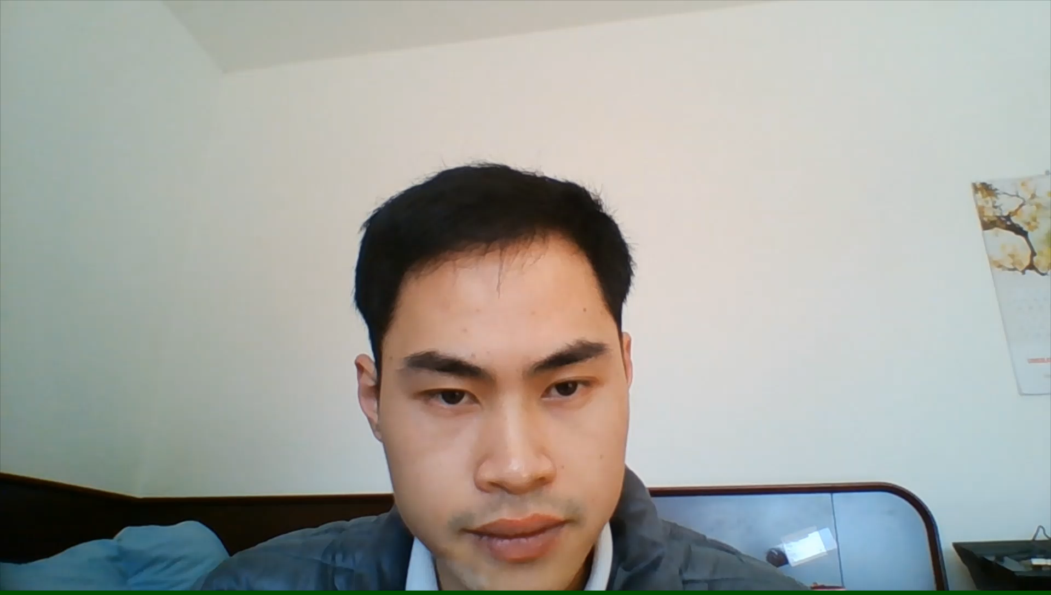
Methods - summarization
Noise-free input
Noise-free output
SCALAR ENCODER
SPATIAL POOLER
Noisy inputs
Noisy output
Possible input values in decreasing order
“Hamming” between an input value and the next one

Slide 20
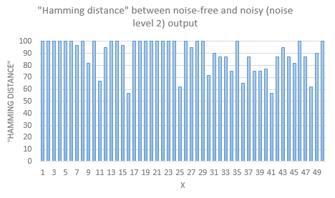
Result and Discussion - Robustness
Figure 3. "Hamming distance" between original and noisy (noise level 2) Spatial Pooler output data (for clarity, only the first 50 samples are shown here)

Slide 21
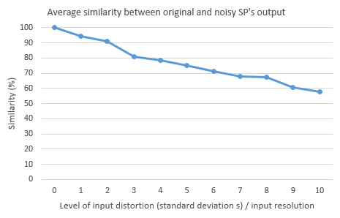
Result and Discussion - Robustness
Figure 4. Average similarity between original and different levels of noisy input data

Slide 22
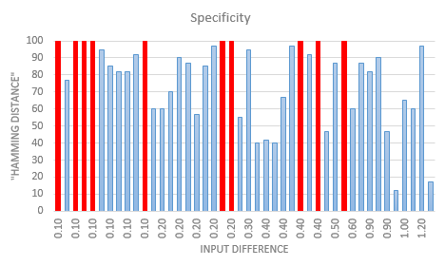
Result and Discussion - Specificity
Figure 5. "Hamming distance" between outputs of trained Spatial Pooler with respect to two consecutively incremental input values regarding amplitude

Slide 23
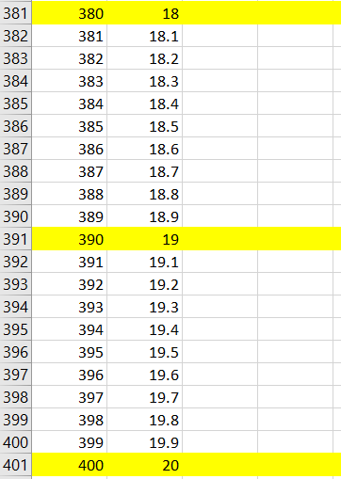
Result and Discussion
2 data sets: Training set and testing set.
Training set: Integer numbers only, ranging from -20 to 20 with step of 1.
Testing set (noisy set): Decimal numbers, same range as above with step of 0.1.
SP learns only about training set then will have to predict testing set (decimal numbers).
Calculate average hamming distance for every numbers from every 0.1 step to the original integer to see how different the patterns are.

Slide 24
Result and Discussion
Figure 6. Average "Hamming distance" between each 0.1 decimal step and the integer number

Slide 25
Conclusion
Noise robustness: robust against relatively low levels of noise
Specificity: Moderate ability to differentiate two consecutively incremental input values

Slide 26
Reference
[1] J. Hawkins and S. Blakeslee, On intelligence. New York: Times Books/Henry Holt, 2008.
[2] J. Hawkins and C. Maver, “Introduction Chapter,” in Biological and Machine Intelligence, Release 0.4., Numenta, 2016.
[3] J. Hawkins and C. Maver, “HTM Overview Chapter,” in Biological and Machine Intelligence, Release 0.4., Numenta, 2016.
[4] S. Purdy, “Encoding Data for HTM Systems,” in Biological and Machine Intelligence, Release 0.4., Numenta, 2016.
[5] S. Ahmad, M. Taylor, and Y. Cui, “Spatial Pooling Algorithm Details,” in Biological and Machine Intelligence, Release 0.4., Numenta, 2016.
[6] A. Lavin, S. Ahmad, and J. Hawkins, “Sparse Distributed Representations,” in Biological and Machine Intelligence, Release 0.4., Numenta, 2016.
[7] S. Ahmad and M. Lewis, “Temporal Memory Algorithm Details,” in Biological and Machine Intelligence, Release 0.4., Numenta, 2016.
[8] D. Dobric, “Influence of input sparsity to Hierarchical Temporal Memory Spatial Pooler noise robustness,” 2019.
[9] D. Dobric, “NeoCortexApi,” 2019. [Online]. Available: https://github.com/ddobric/neocortexapi/

Slide 27
Thank you for your time

